Slide 1
An Introduction to CellChat
Short Read Workshop, Day 8
Georgia Barone

Slide 2
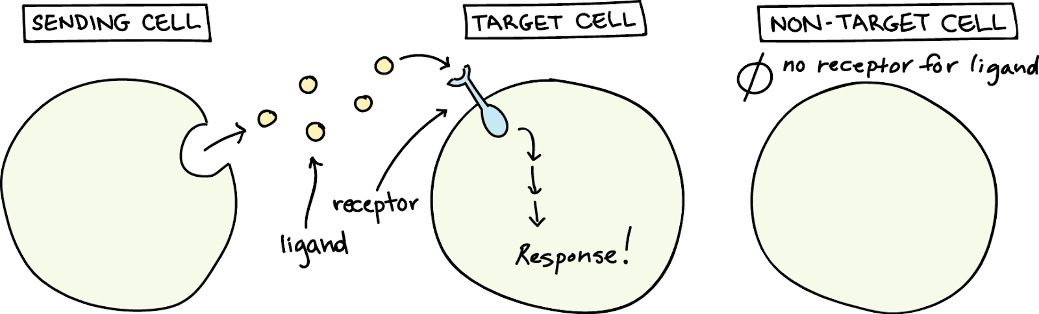
Cell-cell interactions coordinate cellular function
(Khan Academy)

Slide 3
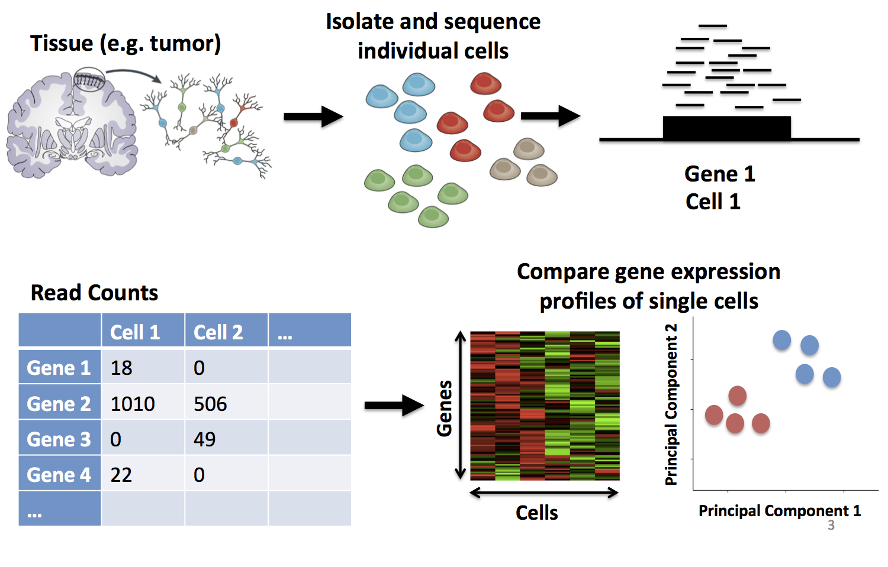
CellChat leverages single-cell RNA sequencing data to evaluate cellular function
Input: scRNA-seq

Slide 4
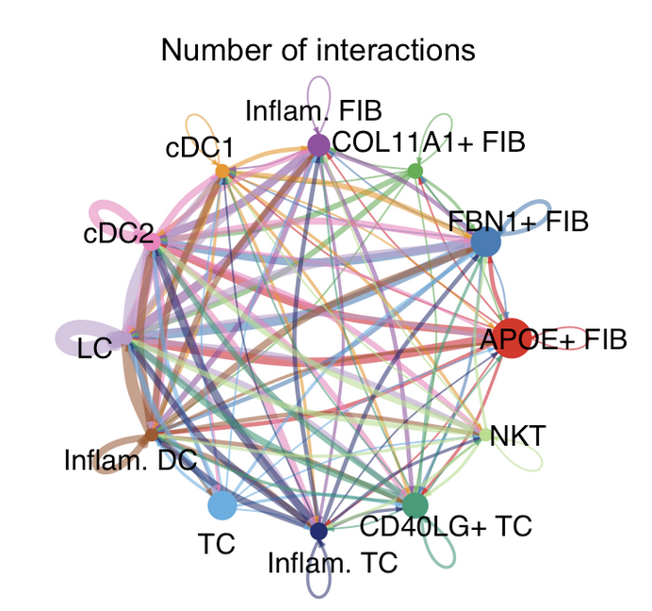
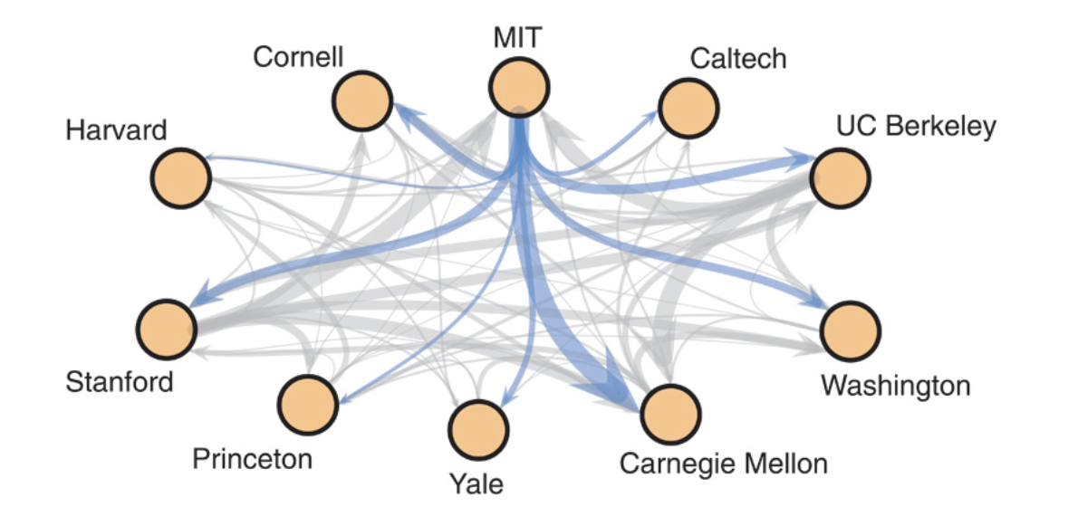
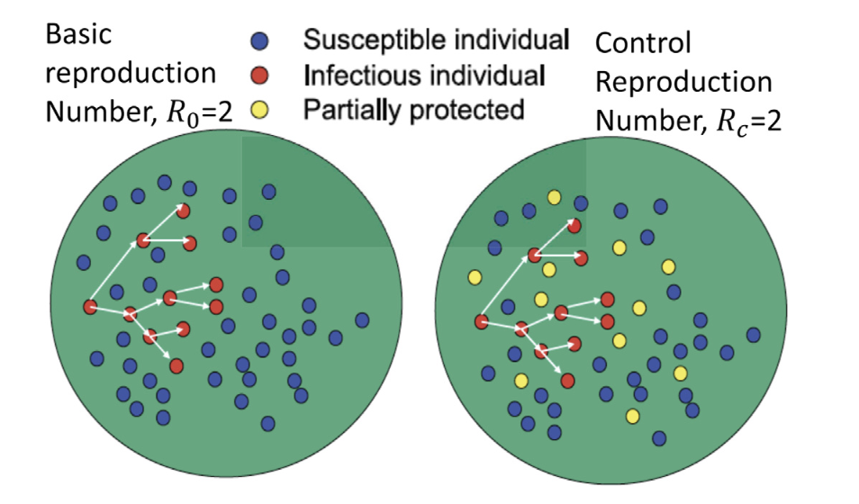
A network is a connected set of nodes and edges
(Larremore, 2015)
(Gumel, 2021)

Slide 5
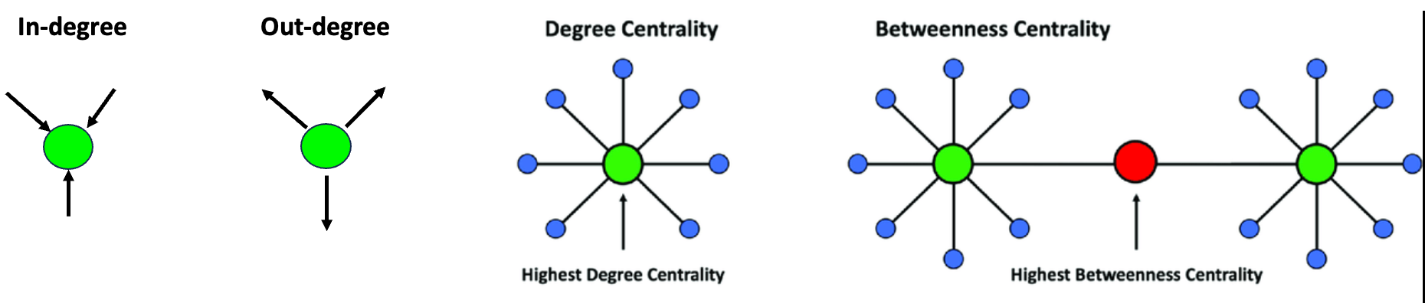
CellChat utilizes a networks-based framework to model cell-cell communication
Cross reference a ligand-receptor interaction database
2. Inference and visualization of intercellular communications
3. Quantitative Analysis
Manually curated and validated signaling molecule interaction database (CellChatDB)
Identify differentially over expressed ligand-receptor pairs
Build network (nodes = cell types; weighted edges = cell-cell communication probability)
Determine major signaling targets, sources, mediators, and influencers

Slide 6
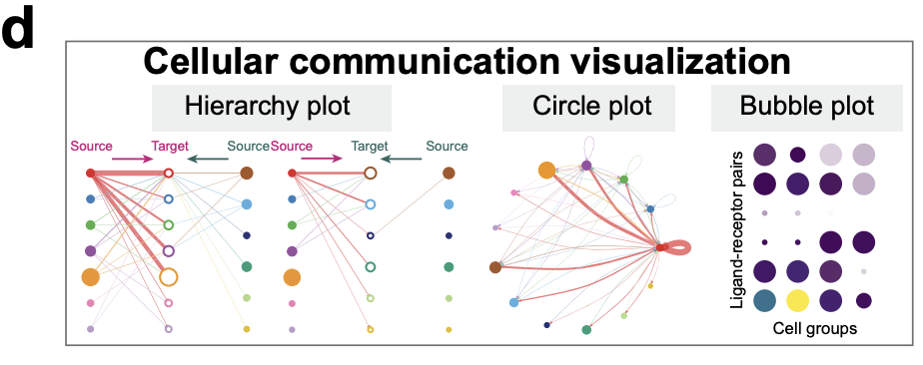
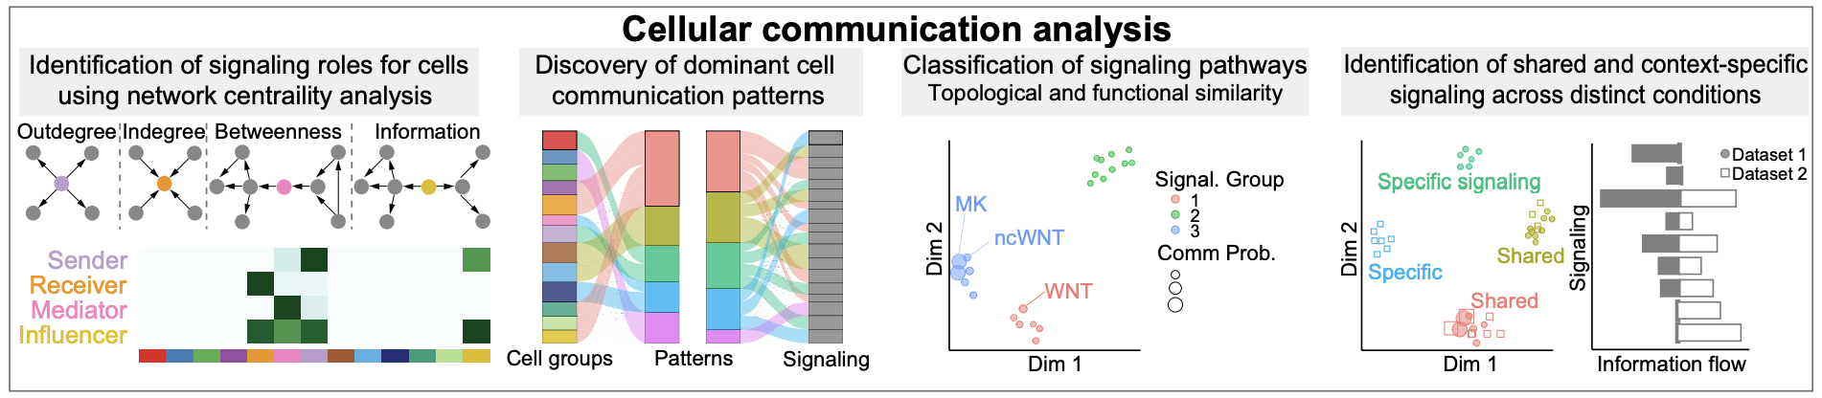
CellChat utilizes a networks-based framework to model cell-cell communication
Output:

Slide 7


How to run CellChat
Load in Seurat object
poop
2. Convert Seurat object to CellChat object

Slide 8

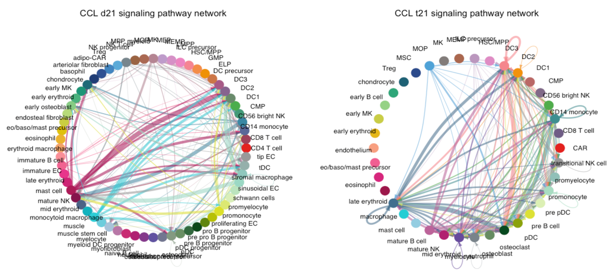
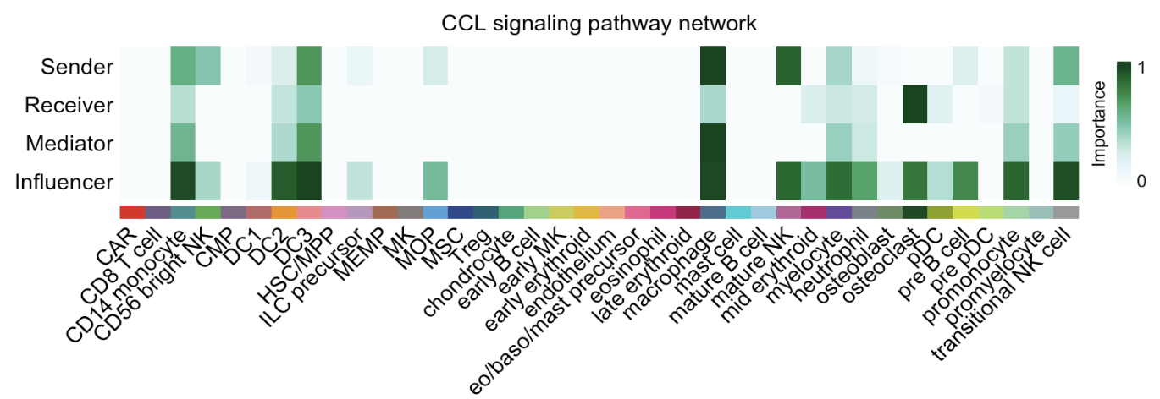
How to run CellChat
3. Calculate cell-cell communication probabilities
4. Visualize results

Slide 9
Example output:

Slide 10
Example output:

Slide 11
Work on Get-Started-With-CellChat.R
1. Run CellChat on a scRNA-seq data set from fetal bone marrow tissue of an individual with trisomy 21
2. If you finish early, run CellChat on another Seurat Object in the day9/. Look for interesting differences between the trisomic and disomic samples.

Slide 12

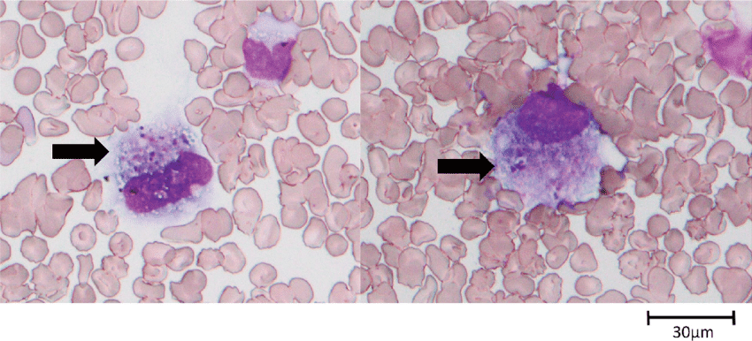
A Biological Conclusion…
Platelet concentration in T21 patients is lowered
While a heightened macrophage activity through the CCL pathway is crucial for making blood platelets it must be finely balanced
CCL dysregulation can lead to chronic inflammation, contributing to a range of chronic diseases and extra stress on the body
(Daisuke Hatanaka, 2022)

Slide 13
Cell-cell communication networks in the CCL pathway are altered in trisomy 21 fetus
Notes:
Graph:
Nodes are cell types
Connections are lines; higher weight- thicker the band
Thicker connections mean a higher strength signal between the two cell types
Macrophage cell-cell communication heavily enhanced in fetus with down syndrome
T21 fetus probably trying to make blood platelets; but is unable to sustain blood platelet formation (T21 phenotype)
Upregulation of CCL pathway in order to stimulate platelet production can cause overall dysregulation of the immune system in patients with down syndrome
This dysregulated immune system makes these patients more susceptible to having more severe symptoms upon viral infection (eg: covid, cold)
https://www.ncbi.nlm.nih.gov/pmc/articles/PMC8267813/

Slide 14
Overall:
There are more macrophage cells in the T21 fetus sending and receiving signals to other cells
Notes:
Now when we look at this same pathway in the T21 data, we can see that a lot of the cell-cell communications between cell types gets stronger (heightened immune response in t21 patients; this is what we would expect to see)

